Slide 1
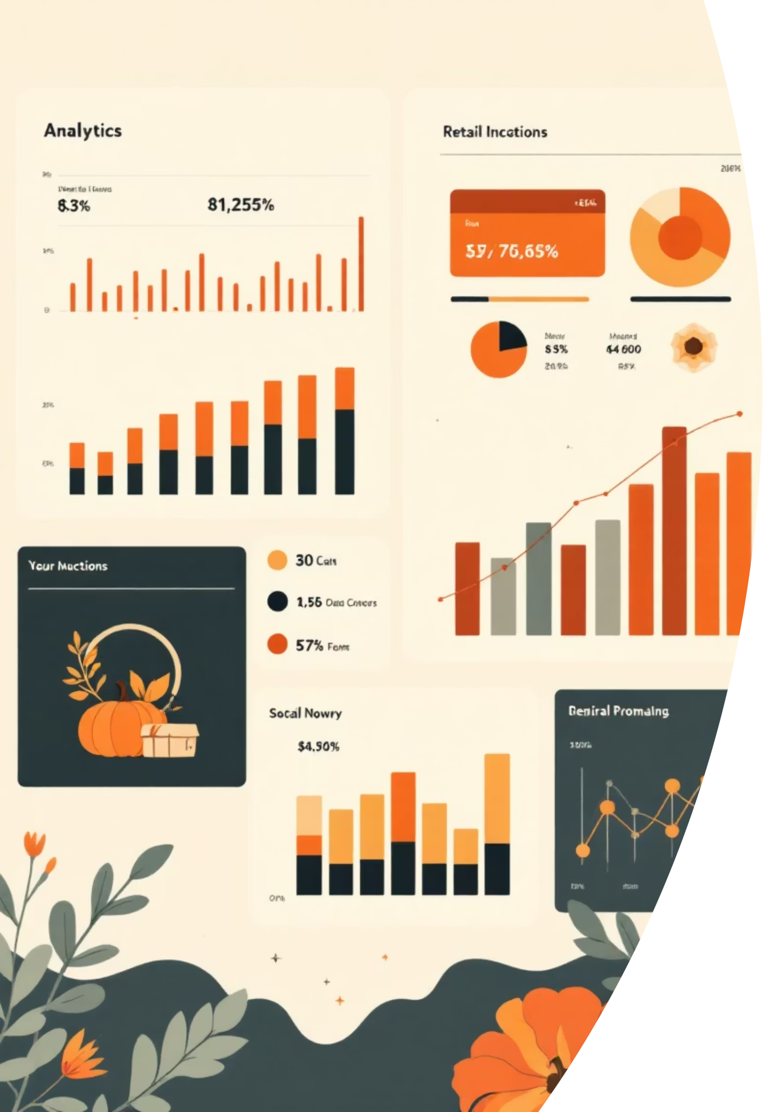
Customer Shopping Behavior Analysis
Analyzing 3,900 customer transactions to uncover spending patterns, preferences, and strategic opportunities across product categories and customer segments.

Slide 2

DATASET OVERVIEW
Understanding Our Data Foundation
3,900
18
50
25
Total Purchases
Data Columns
Locations
Products
Transactions analyzed across all categories
Features tracking demographics and behavior
Geographic diversity in customer base
Unique items across four categories
Key features include customer demographics, purchase details, shopping behavior metrics, and subscription status. Only 37 missing values found in Review Rating column.

Slide 3

PYTHON ANALYSIS
Data Preparation & Engineering
Data Cleaning
Feature Engineering
Loaded dataset using pandas
Created age_group bins for segmentation
Imputed missing Review Ratings with median by category
Generated purchase_frequency_days metric
Standardized columns to snake_case
Dropped redundant promo_code_used column
Verified data consistency
Integrated with PostgreSQL database

Slide 4


REVENUE INSIGHTS
Gender Revenue Comparison
Male Customers
$157,890 total revenue
Representing 68% of total sales
Female Customers
$75,191 total revenue
Representing 32% of total sales
Male customers generate more than double the revenue of female customers, suggesting opportunities for targeted marketing campaigns to balance gender representation.

Slide 5
Top-Rated Products Drive Satisfaction
1
2
3
Gloves
Sandals
Boots
Average rating: 3.86
Average rating: 3.84
Average rating: 3.82
4
5
Hat
Skirt
Average rating: 3.80
Average rating: 3.78

Slide 6



CUSTOMER SEGMENTS
Understanding Customer Loyalty
New
1
83 customers
Returning
2
701 customers
Loyal
3
3,116 customers
The vast majority (80%) of customers fall into the Loyal segment, demonstrating strong retention. Focus on converting New and Returning customers into Loyal advocates.

Slide 7
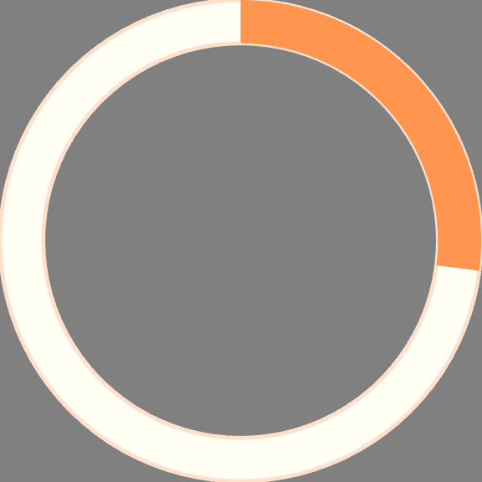
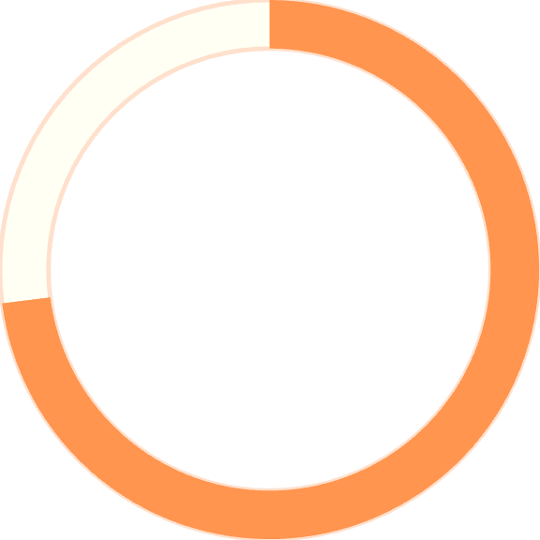
Subscription & Spending Patterns
Key Finding: Subscribers spend $59.49 on average vs. $59.87 for non-subscribers—minimal difference suggests subscription benefits need enhancement.
27%
Among repeat buyers (5+ purchases), 958 are subscribers while 2,518 are not, indicating untapped subscription potential.
Subscribers
1,053 customers with subscriptions
73%
Non-Subscribers
2,847 customers without subscriptions

Slide 8
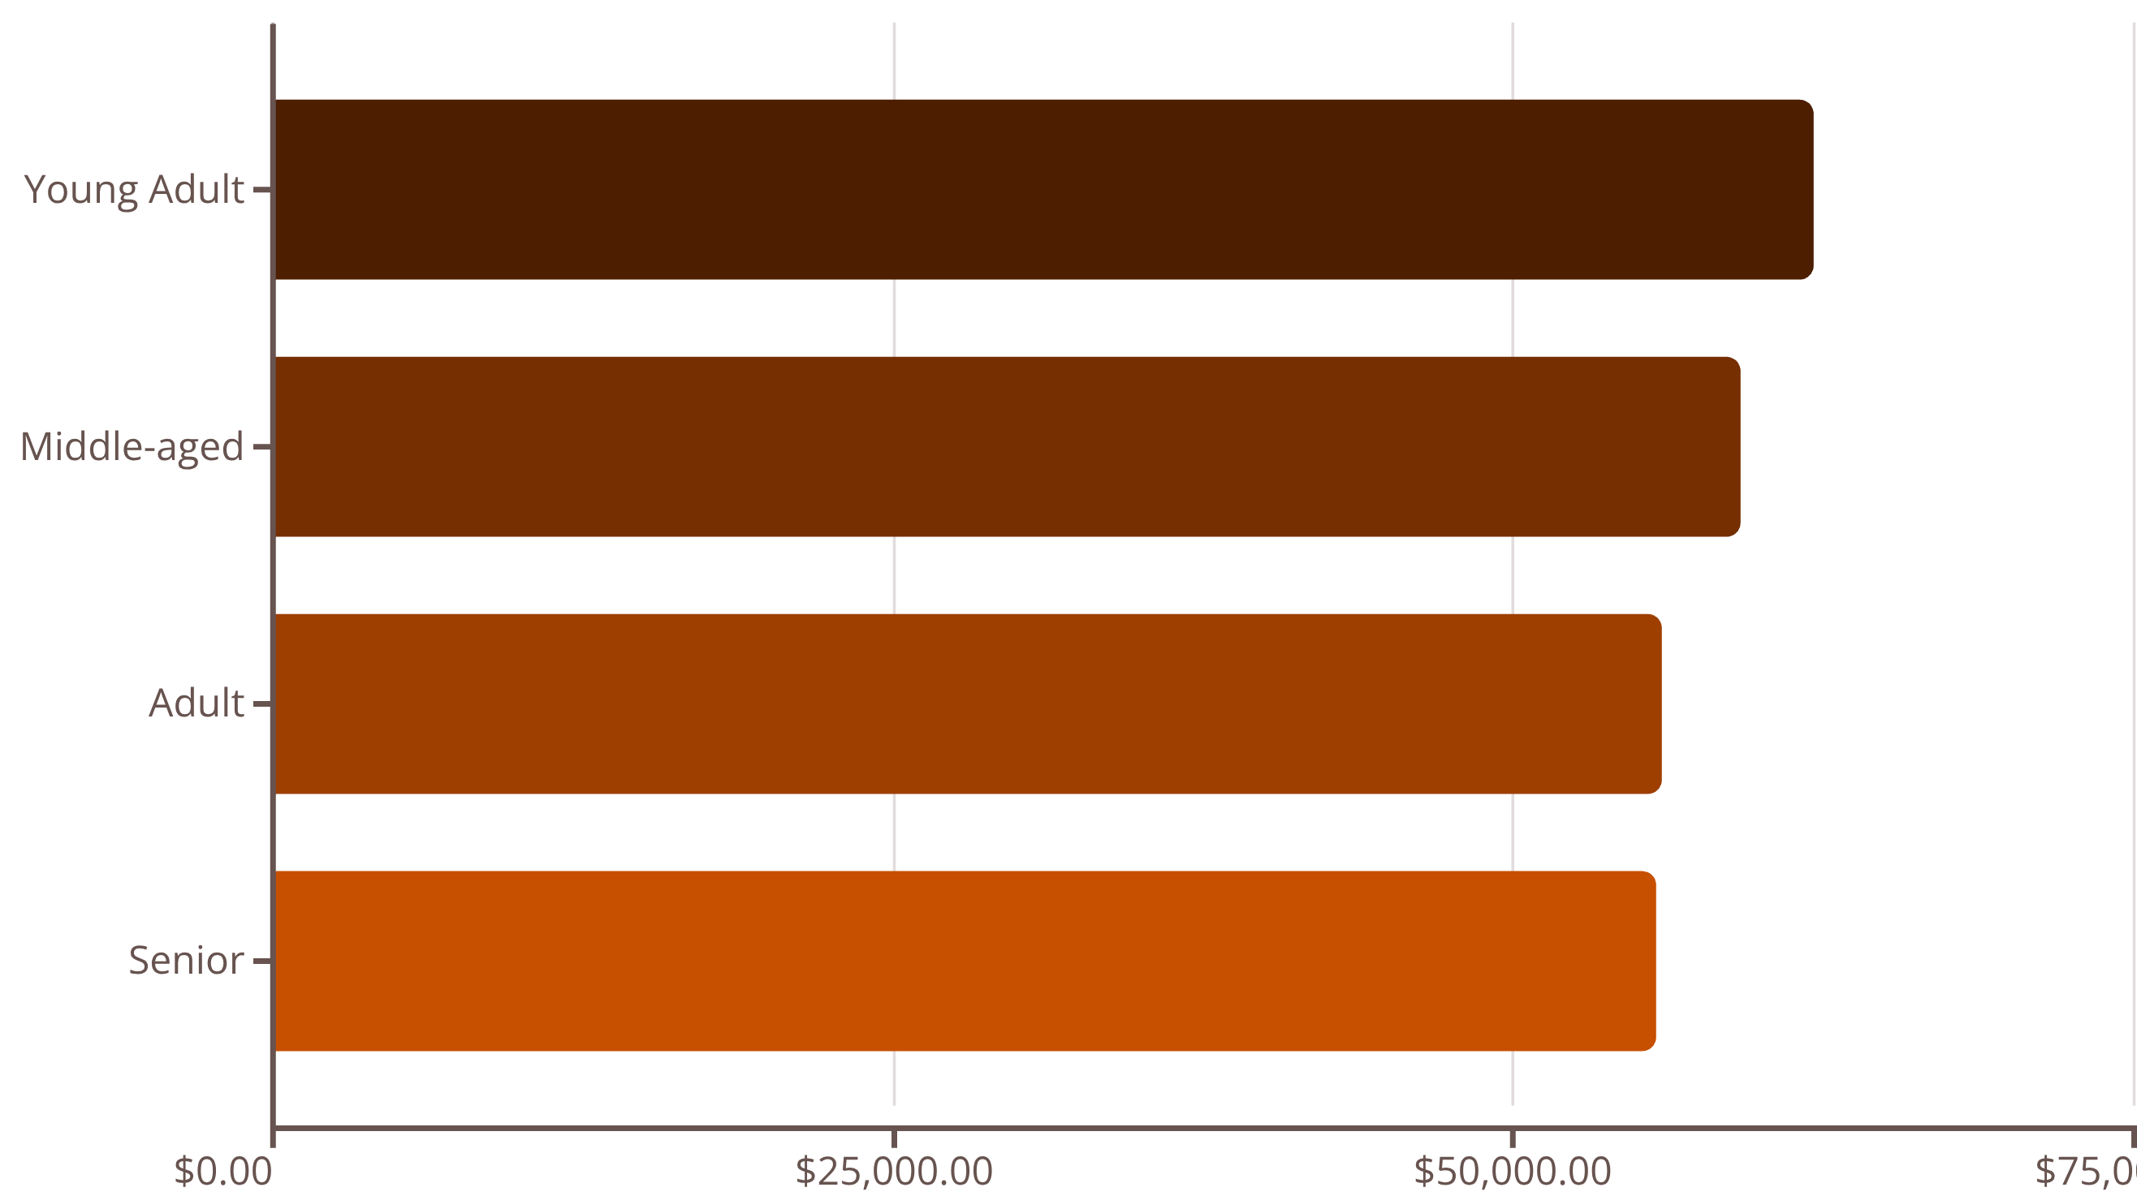
DEMOGRAPHICS
Revenue by Age Group
Young Adults lead revenue generation at $62,143, followed closely by Middle-aged customers. Revenue distribution is relatively balanced across age groups, suggesting broad market appeal.

Slide 9

Discount Strategy Insights
High-Value Discount Users
839 customers used discounts but still spent above average ($59.76), demonstrating that discounts don't always reduce transaction value.
Discount-Dependent Products
Hats (50%), Sneakers (49.66%), and Coats (49.07%) have highest discount rates—consider if margins support this strategy.
Shipping Preferences
Express shipping customers spend $60.48 vs. $58.46 for Standard—premium shipping correlates with higher purchase amounts.

Slide 10





STRATEGIC RECOMMENDATIONS
Driving Growth Through Data
Boost Subscriptions
Promote exclusive benefits to convert the 73% non-subscriber base, especially among repeat buyers.
Loyalty Programs
Reward repeat buyers to accelerate movement from Returning to Loyal segments.
Targeted Marketing
Focus on Young Adults and express-shipping users who demonstrate higher spending patterns.
Product Positioning
Highlight top-rated products (Gloves, Sandals, Boots) in campaigns to drive conversions.
Review Discount Policy
Balance promotional sales boosts with margin control, especially for discount-dependent products.

